Slide 1

Wellpack-Weather Prediction
Intelligent weather forecasting system
Designed for operational and campaign planning
Transforms raw weather data into actionable insights

Slide 2
Why this tool?
Weather strongly impacts field operations and campaigns
Raw forecasts are not decision-oriented
Manual interpretation is slow and inconsistent
Need for scalable, automated optimization

Slide 3



Forecasting Modes
Quick Forecast
Detailed Forecast
Batch Processing (Pro CSV)
Instant, specific date & time checks
Best operational hours over multiple days
Large-scale automated forecasting

Slide 4
Platform Overview
3 modes, 1 consistent pipeline
Quick Forecast
Detailed Forecast
Shoot Extractor
Postal code → up to 5 (date, time) points
Hourly metrics + daily min/max
5‑day window
Top‑3 hours/day + overall best 3
CSV/Excel → datetime parse → location resolve
Weather fetch → XLSX export
Input postal
Input postal
Upload file
Fetch forecast
Fetch hourly+daily
Resolve location
Show table
Score & rank
Export XLSX
Notes:
[Sources] - Open‑Meteo docs (hourly/daily variables & timezone param): https://open-meteo.com/en/docs - Open‑Meteo archive endpoint: https://open-meteo.com/en/docs/historical-weather-api [/Sources]

Slide 5
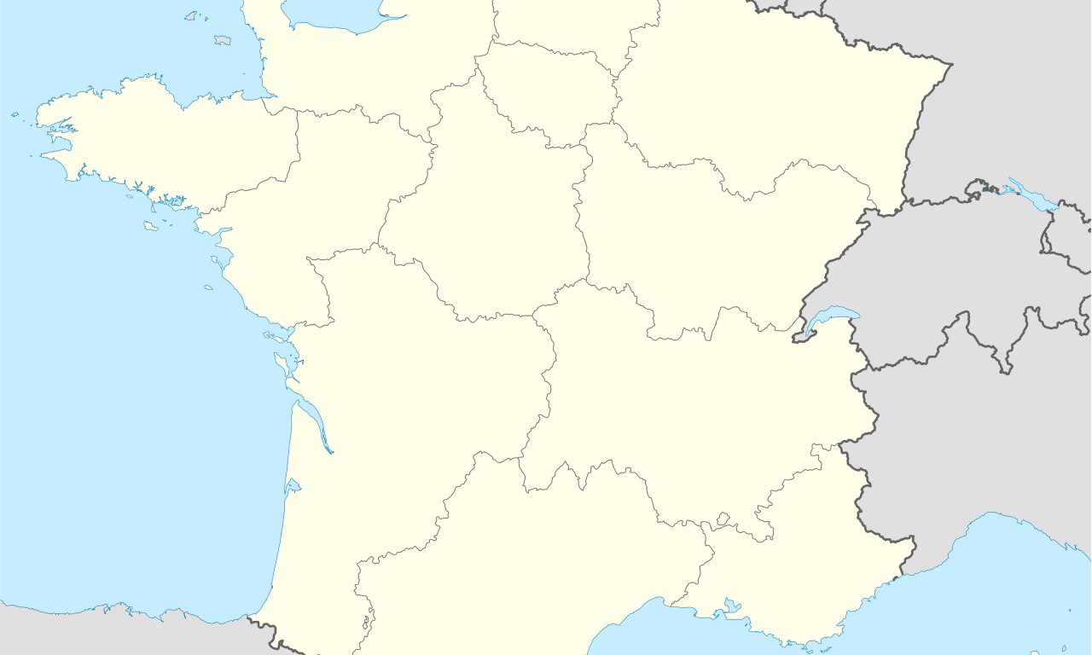

Mode 1 — Quick Forecast
4
Quick Forecast: postal code + 5 datetime points
User inputs
What’s fetched & calculated
Postal code (France)
Geocode postal code → (lat, lon) via API Geo communes lookup.
Open‑Meteo forecast: hourly (temp, wind, precip/rain/showers/snow, humidity, cloud cover).
Daily min/max temperature for that date.
Nearest‑hour selection for each requested datetime.
94320
Pick up to 5 date/time points
D1
T1
D2
T2
D3
T3
D4
T4
D5
T5
Generate forecast
Output (table)
Requested Datetime | Location | Temp | Wind | Tmin | Tmax | Rain | Snow
… 5 rows (one per input datetime)
Notes:
[Sources] - API Geo communes (postal code search): https://geo.api.gouv.fr/decoupage-administratif/communes - Open‑Meteo forecast endpoint: https://open-meteo.com/en/docs [/Sources]

Slide 6
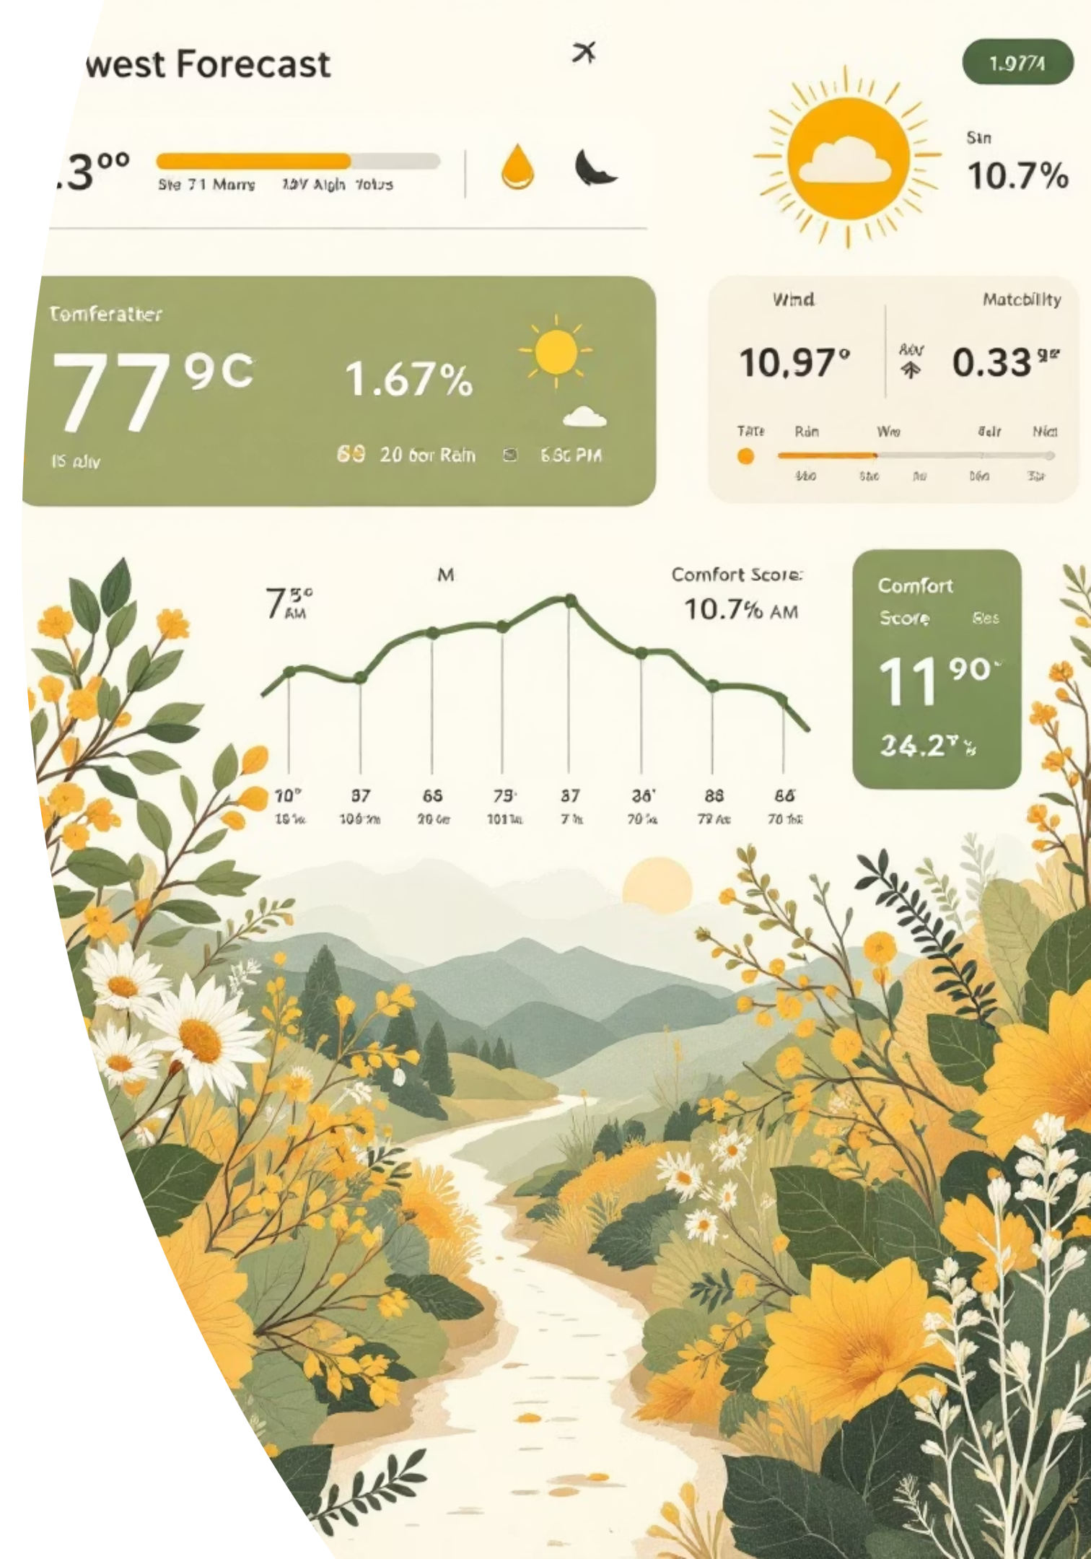




Mode 2 — Detailed Forecast
Detailed Forecast: Top‑3 Hours/Day for 5 Days
Comprehensive Data Fetch
Obtains 5-day hourly weather data, including daily min/max temperatures.
Comfort Score Calculation
Computes a unique "comfort score" per hour, considering temperature, rain, humidity, wind, and cloud cover.
Daily Top 3 Ranking
Ranks hours within each day to present the Top 3 most comfortable periods.
Overall Top 3 Identification
Identifies and displays the overall Top 3 most comfortable hours across the entire 5‑day forecast window.

Slide 7
Mode 3 — Shoot Weather Extractor
6
Shoot Weather Extractor: CSV/Excel → XLSX output
Upload
CSV / XLSX
Parse
datetime
Extract
location
Messages + shoot datetime
French dates supported
Regex + spaCy NER
Resolve
(lat, lon)
Fetch
weather
Export
XLSX
City → postal → BAN
Forecast or archive
Results + best hour
Optional filters:
Remove rows with NO extracted location
Remove rows invalid after resolution
Notes:
[Sources] - BAN / api-adresse documentation: https://doc.adresse.data.gouv.fr/naviguer-sur-le-site/les-api - Open‑Meteo forecast docs: https://open-meteo.com/en/docs - Open‑Meteo archive docs: https://open-meteo.com/en/docs/historical-weather-api [/Sources]

Slide 8



Location Extraction
Location Extraction: Layered, Pragmatic Rules for Precision
1
1) Extract "Hints" from the Message
2
2) Clean & Validate Candidates
Identifies store code patterns like [[ABC123]].
Normalizes accents, punctuation, and URLs for consistent data.
Extracts the first 5‑digit number as a potential postal code.
Trims common stop‑words that interfere with location identification.
Parses city candidates based on common French prepositions (e.g., "à/au/aux …").
Validates city names against API Geo, boosting accuracy by population size.
If city/postal fails, falls back to BAN address search with a defined score threshold.
Applies brand-specific rules for known locations (e.g., "Carrefour …").
Utilizes spaCy NER as a fallback for recognizing LOC/GPE/FAC entities.
Last resort: longest ALL‑CAPS token (>=4 characters).

Slide 9


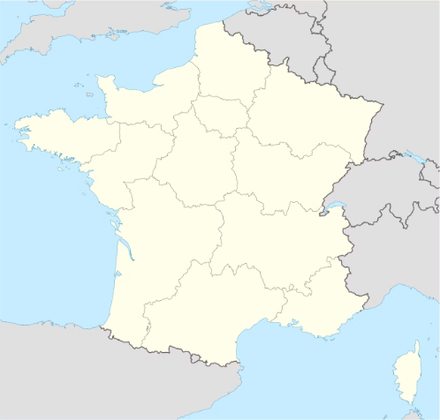
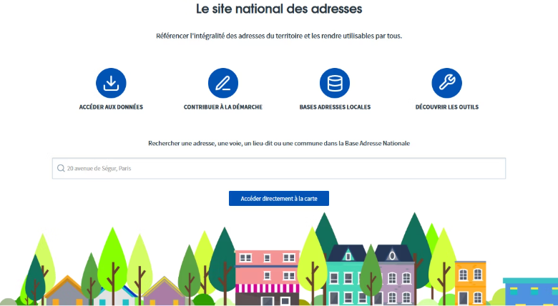

Data Sources
External APIs Used (France) for Robust Weather Data
API Geo
BAN / API Adresse
Open-Meteo
Utilizes geo.api.gouv.fr to convert postal codes to communes and centroid (latitude/longitude), and for city validation with population boosting, ensuring fast and reliable French lookups.
Provides free address search for France, serving as a crucial "last resort" geocoder with a score threshold (>= 0.50) to accept results, ensuring maximum coverage.
Accesses forecast endpoints for upcoming shoots and archive endpoints for past shoots, delivering hourly and daily variables aligned to Europe/Paris timezone for accuracy.

Slide 10

Output
Excel Output: Practical Columns for Operations & Planning
1
2
Identity & Parsing
Weather Metrics
Message
Forecast Time (nearest hour)
Shoot Datetime
Temperature, Wind
Store Code (optional)
Daily Tmin/Tmax
Extracted City / Postal
Rain (mm), Snow (mm)
Resolved Location / Postal / Method
Best Time of Day + Best Temp
The output is conveniently delivered in a single Excel sheet, named shoot_weather, providing all critical information at a glance for streamlined production decisions.

Slide 11

Comfort Score Logic
Single metric summarizing weather suitability
Optimized temperature range
Penalization for rain, wind, cloud, humidity
Higher score = better operational conditions

Slide 12
Engineering Notes
Performance & Reliability Highlights for a Seamless Experience
What's Already in Place
Caching (spaCy model via st.cache_resource; API responses via st.cache_data)
Safe CSV loading across encodings + separators
Graceful fallbacks when geocoding and weather data retrieval fails
Timezone pinned to Europe/Paris for consistent hourly alignment

Slide 13

Strategic & Advanced Future Enhancements
Campaign-Aware Weather Intelligence Engine
Automated SMS Trigger System
Predictive Campaign Success Scoring
Multi-Day Optimization & Scheduling Engine
Operational Risk & Confidence Index
Client-Level Customization & API Integration

